Slide 1
Building Nested Components

Slide 2


Slide 3

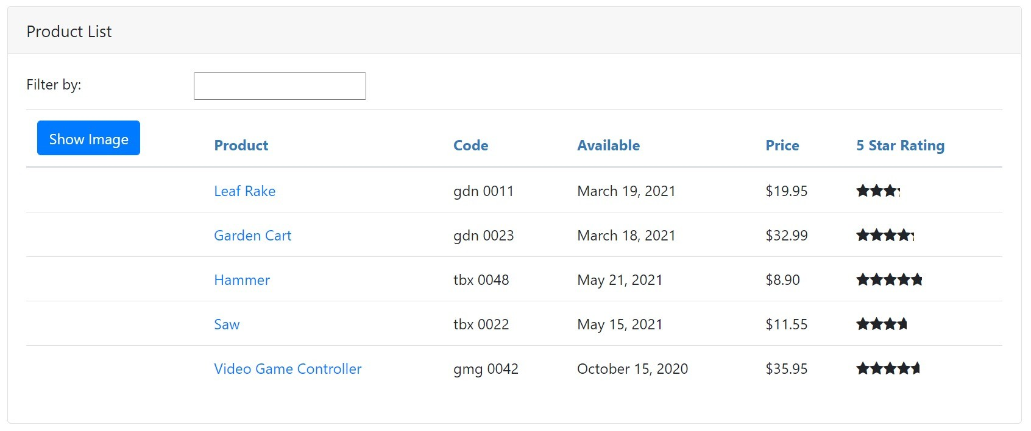
Using a Component
As a Directive
As a Routing target
App Component OR Nested Component
Full page style view
<body>
<pm-root></pm-root>
</body>

Slide 4
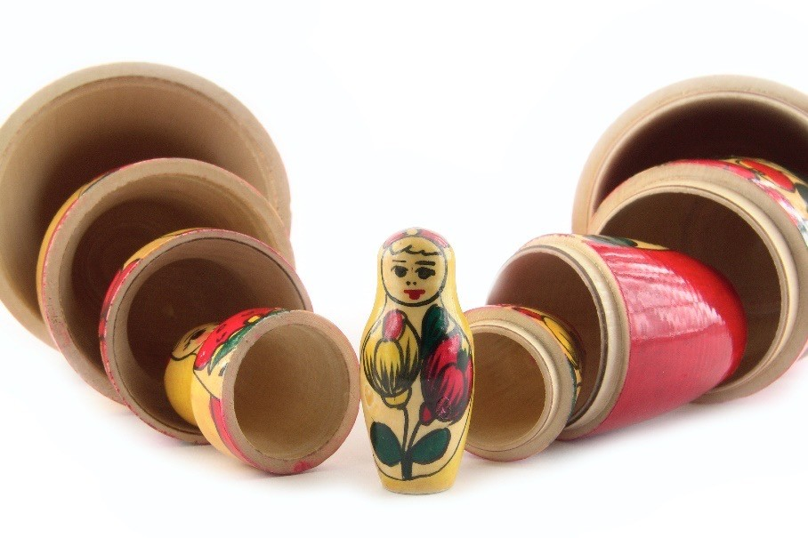
What Makes a Component Nest-able?
Its template manages a fragment of a larger view
It has a selector
It optionally communicates with its container

Slide 5

Building a nested component
Using a nested component
Module Overview
Passing data to a nested component using @Input
Raising an event from a nested component using @Output

Slide 6
Application Architecture
Welcome Component
index.html
App Component
Product List Component
Star Component
Product Detail Component
Product Data Service

Slide 7
Building a Nested Component
Container Component
Template
Nested Component
<pm-star> </pm-star>
Template
Class
Class

Slide 8
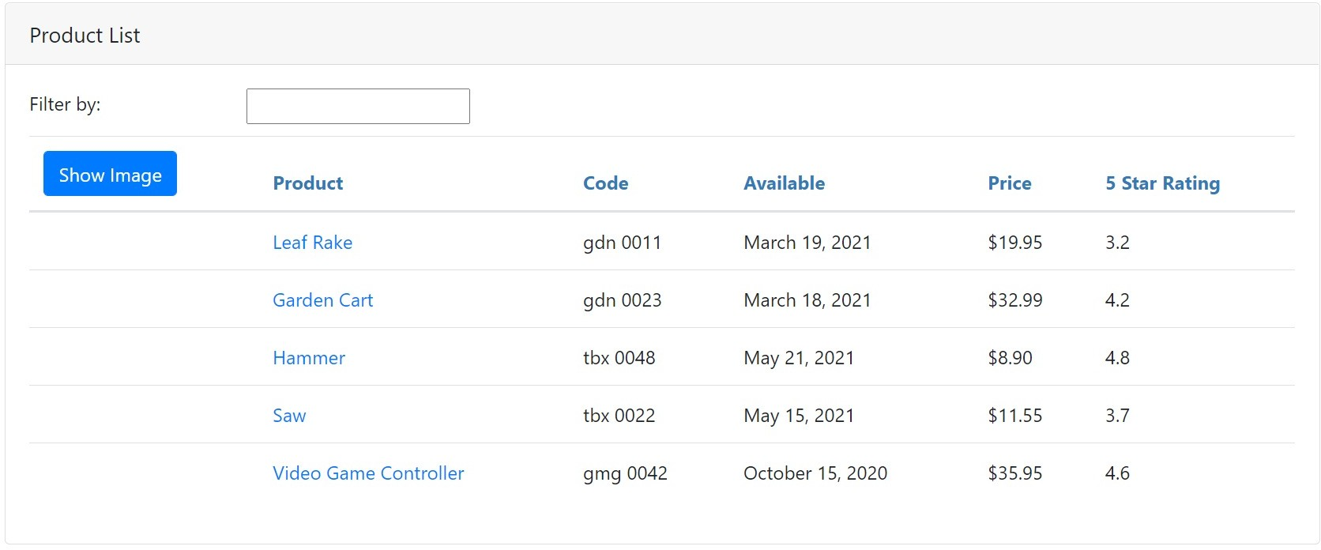
Product List View

Slide 9
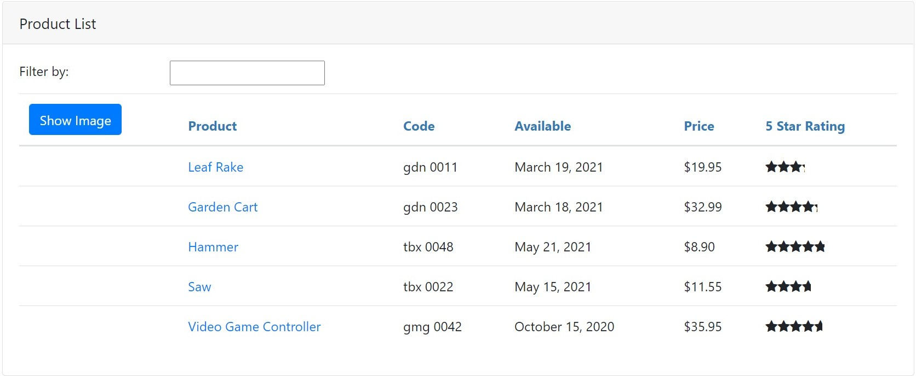
Product List View

Slide 10
Using a Nested Component as a Directive
product-list.component.ts
star.component.ts
@Component({
selector: 'pm-products', templateURL: './product-list.component.html'
})
export class ProductListComponent { }
@Component({
selector: 'pm-star', templateURL: './star.component.html'
})
export class StarComponent { rating: number;
cropWidth: number;
}
product-list.component.html
<td>
{{ product.starRating }}
</td>

Slide 11
Using a Nested Component as a Directive
product-list.component.ts
star.component.ts
@Component({
selector: 'pm-products', templateURL: './product-list.component.html'
})
export class ProductListComponent { }
@Component({
selector: 'pm-star', templateURL: './star.component.html'
})
export class StarComponent { rating: number;
cropWidth: number;
}
product-list.component.html
<td>
<pm-star></pm-star>
</td>

Slide 12
BrowserModule
FormsModule
AppModule
AppComponent
ProductList - Component
ConvertToSpaces- Pipe
StarComponent
Imports Exports Declarations Bootstrap

Slide 13
Telling Angular About Our Component
app.module.ts
...
import { StarComponent } from './shared/star.component';
@NgModule({ imports: [
BrowserModule, FormsModule ],
declarations: [ AppComponent,
ProductListComponent,
ConvertToSpacesPipe, StarComponent ],
bootstrap: [ AppComponent ]
})
export class AppModule { }

Slide 14
Building a Nested Component
Container Component
Template
<pm-star> ^{Nested Component} </pm-star>
Template
Input
Output
Class
Class

Slide 15
Passing Data to a Nested Component (@Input)
Container Component
Template
Nested Component Template
@Input()
<pm-star>
Input
</pm-star>
Class
Class

Slide 16
Passing Data to a Nested Component (@Input)
product-list.component.ts
star.component.ts
@Component({
selector: 'pm-products', templateURL: './product-list.component.html'
})
export class ProductListComponent { }
@Component({
selector: 'pm-star', templateURL: './star.component.html'
})
export class StarComponent { @Input() rating: number; cropWidth: number;
}
product-list.component.html
<td>
<pm-star></pm-star>
</td>

Slide 17
Passing Data to a Nested Component (@Input)
product-list.component.ts
star.component.ts
@Component({
selector: 'pm-products', templateURL: './product-list.component.html'
})
export class ProductListComponent { }
@Component({
selector: 'pm-star', templateURL: './star.component.html'
})
export class StarComponent { @Input() rating: number; cropWidth: number;
}
product-list.component.html
<td>
<pm-star [rating]='product.starRating'>
</pm-star>
</td>

Slide 18
Emitting an Event (@Output)
Container Component
Template
Nested Component Template
@Input()
<pm-star>
Input
</pm-star>
Output
@Output()
Class
Class

Slide 19

Demo
Handling events

Slide 20
Emitting an Event (@Output)
product-list.component.ts
star.component.ts
@Component({
selector: 'pm-products', templateURL: './product-list.component.html'
})
export class ProductListComponent { }
@Component({
selector: 'pm-star',
templateURL: './star.component.html'
})
export class StarComponent { @Input() rating: number; cropWidth: number;
@Output() notify: EventEmitter<string> =
new EventEmitter<string>();
}
product-list.component.html
<td>
<pm-star [rating]='product.starRating'>
</pm-star>
</td>

Slide 21
Emitting an Event (@Output)
product-list.component.ts
star.component.ts
@Component({
selector: 'pm-products', templateURL: './product-list.component.html'
})
export class ProductListComponent { }
@Component({
selector: 'pm-star',
templateURL: './star.component.html'
})
export class StarComponent { @Input() rating: number; cropWidth: number;
@Output() notify: EventEmitter<string> =
new EventEmitter<string>();
onClick() { this.notify.emit('clicked!');
}
}
product-list.component.html
<td>
<pm-star [rating]='product.starRating'>
</pm-star>
</td>
star.component.html
<div (click)='onClick()'>
... stars ...
</div>

Slide 22
Emitting an Event (@Output)
product-list.component.ts
star.component.ts
@Component({
selector: 'pm-products', templateURL: './product-list.component.html'
})
export class ProductListComponent { }
@Component({
selector: 'pm-star',
templateURL: './star.component.html'
})
export class StarComponent { @Input() rating: number; cropWidth: number;
@Output() notify: EventEmitter<string> =
new EventEmitter<string>();
onClick() { this.notify.emit('clicked!');
}
}
product-list.component.html
<td>
<pm-star [rating]='product.starRating' (notify)='onNotify($event)'>
</pm-star>
</td>
star.component.html
<div (click)='onClick()'>
... stars ...
</div>

Slide 23
Emitting an Event (@Output)
product-list.component.ts
star.component.ts
@Component({
selector: 'pm-products', templateURL: './product-list.component.html'
})
export class ProductListComponent { onNotify(message: string): void { }
}
@Component({
selector: 'pm-star',
templateURL: './star.component.html'
})
export class StarComponent { @Input() rating: number; cropWidth: number;
@Output() notify: EventEmitter<string> =
new EventEmitter<string>();
onClick() { this.notify.emit('clicked!');
}
}
product-list.component.html
<td>
<pm-star [rating]='product.starRating' (notify)='onNotify($event)'>
</pm-star>
</td>
star.component.html
<div (click)='onClick()'>
... stars ...
</div>

Slide 24
Nest-able Component's Public API
Container Component
Template
Nested Component Template
@Input()
<pm-star>
Input
</pm-star>
Output
@Output()
Class
Class

Slide 25
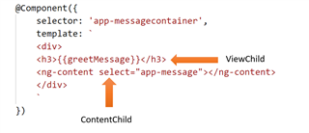
ViewChild and ContentChild in Angular

Slide 26

Nesting Checklist: Input Properties
Input decorator
Attach to a property of any type Prefix with @; Suffix with ()
export class StarComponent {
@Input() rating: number;
}

Slide 27
Nesting Checklist: Output Properties
Output decorator
Attached to a property declared as an EventEmitter Use the generic argument to define the event data type
Use the new keyword to create an instance of the EventEmitter Prefix with @; Suffix with ()
export class StarComponent {
@Output() notify: EventEmitter<string> =
new EventEmitter<string>();
}

Slide 28
Nesting Checklist: Container Component
Use the directive
Directive name -> nested component's selector
Use property binding to pass data to the nested component
Use event binding to respond to events from the nested component
Use $event to access the event data passed from the nested component
<pm-star [rating]='product.starRating' (notify)='onNotify($event)'>
</pm-star>

Slide 29
Application Architecture
Welcome Component
index.html
App Component
Product List Component
Star Component
Product Detail Component
Product Data Service

Slide 30
Application Architecture
Welcome Component
index.html
App Component
Product List Component
Star Component
Product Detail Component
Product Data Service

Slide 31

Coming up next …
Services and Dependency Injection

